Slide 1
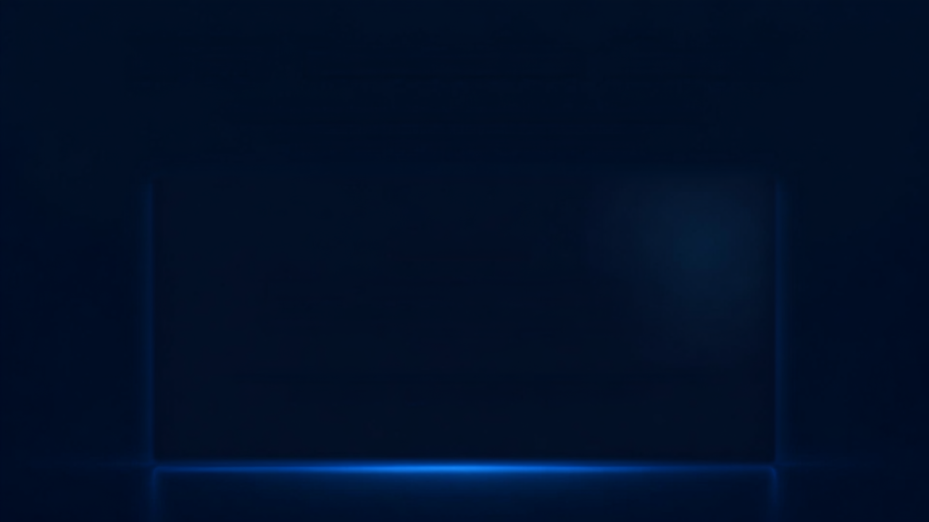
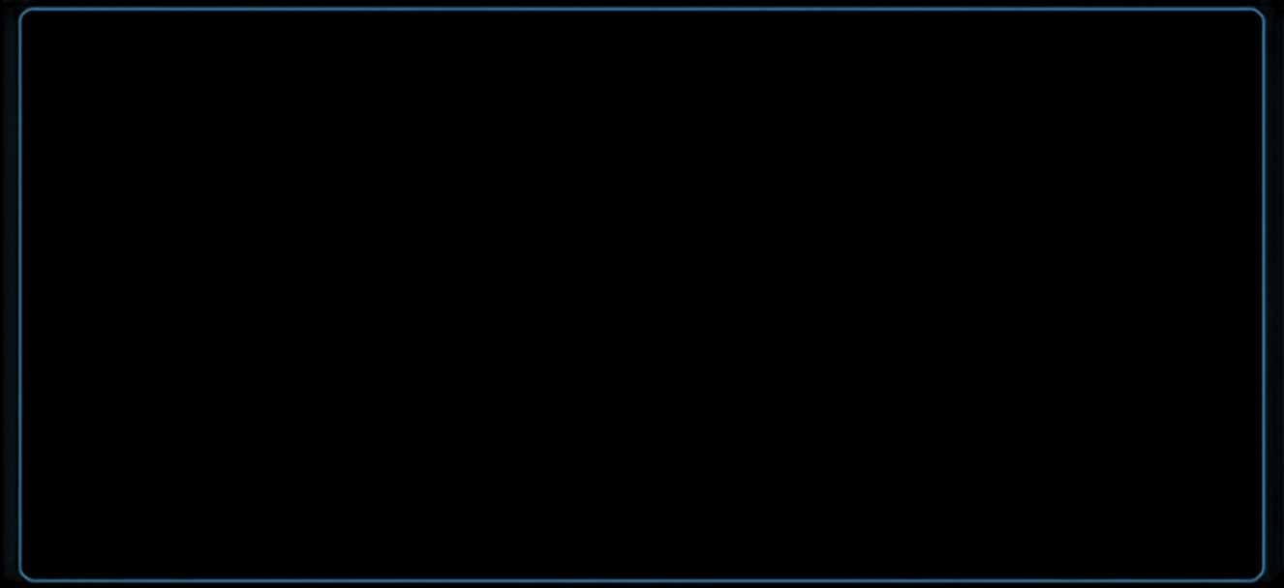

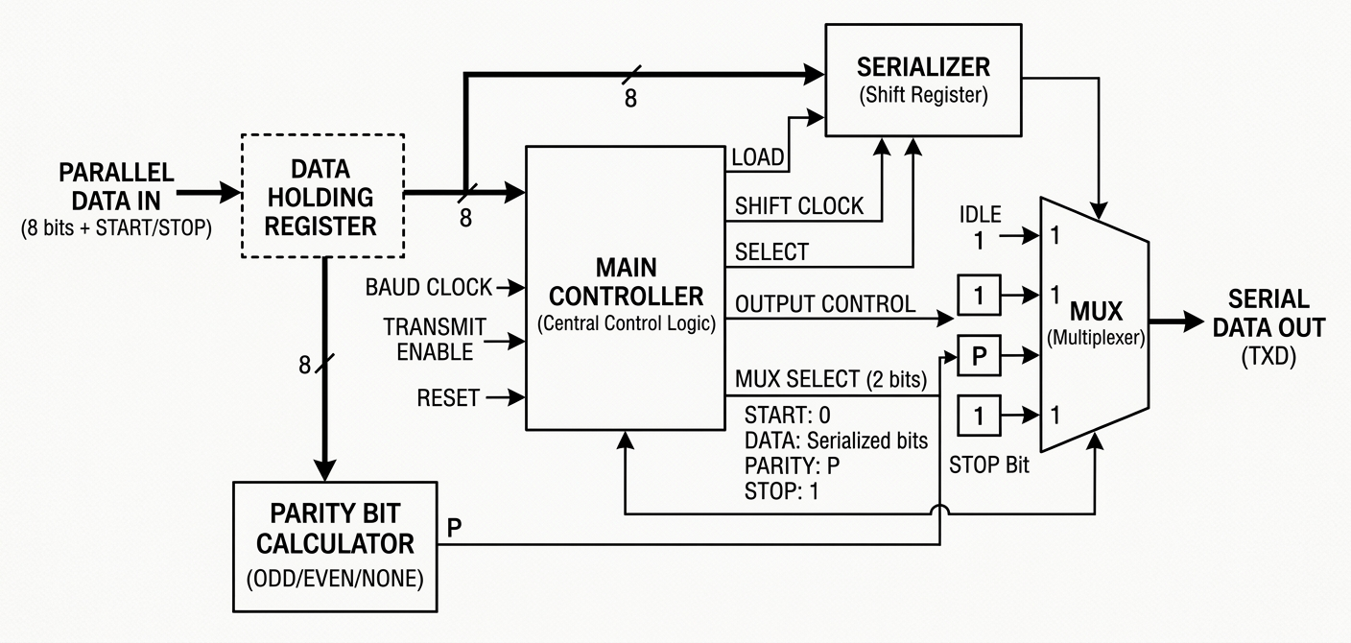
UART Transmitter Module
Hardware Architecture, Block Diagram Process & Synthesizable Verilog Implementation
UART Transmitter Module
VLSI & DIGITAL SYSTEM DESIGN
Hardware Architecture, Block Diagram Process & Synthesizable Verilog Implementation

Slide 2

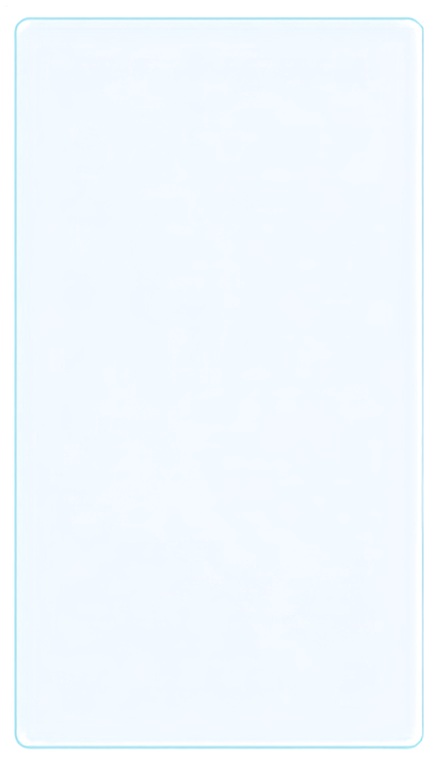
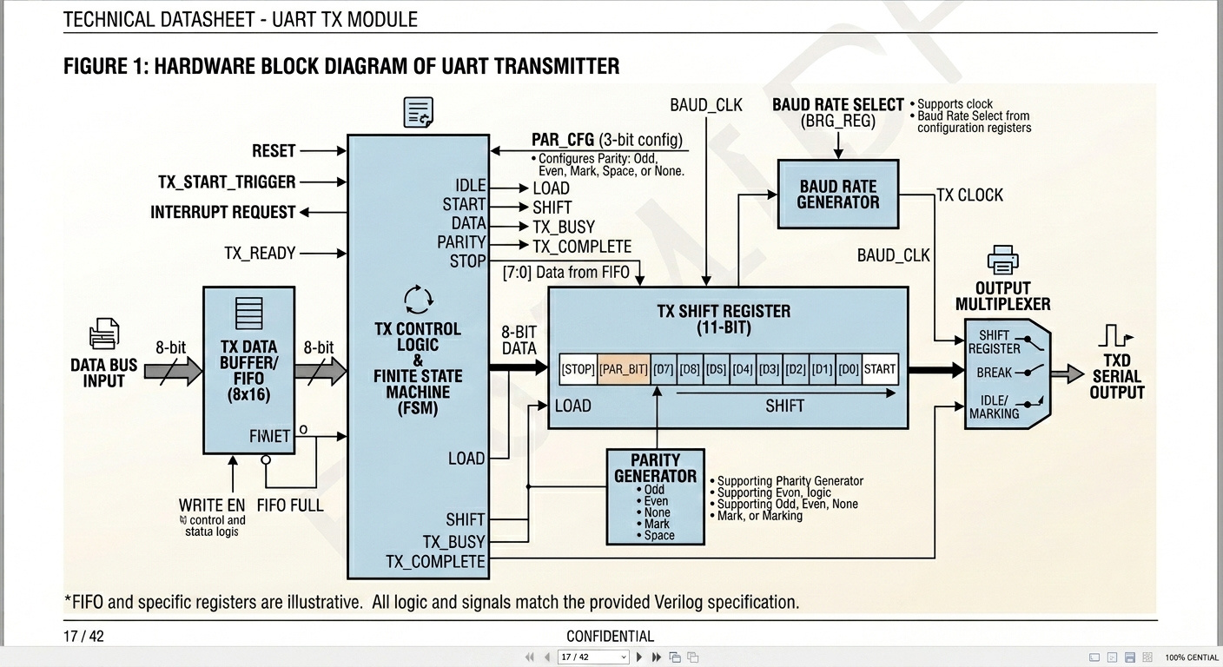
Hardware Block Diagram
UART TRANSMITTER ARCHITECTURE
KEY ARCHITECTURAL COMPONENTS
TX Data Buffer / FIFO
Stores incoming 8-bit data bytes from data bus.
TECHNICAL DATOSHEET - UART TX MODULE
FIGURE 1: HARDWARE BLOCK DIAGRAM OF UART TRANSMITTER
TX Control Logic & FSM
Central controller generating load, shift, and status flags.
Baud Rate Generator
Generates output pulse train for selected transmission speed.
11-Bit Shift Register
Converts parallel data frame into serial stream.
Parity Generator
Computes Odd/Even/Mark/Space parity bits.
Output Multiplexer
Routes Serial, Break, or Idle states to TXD.

Slide 3

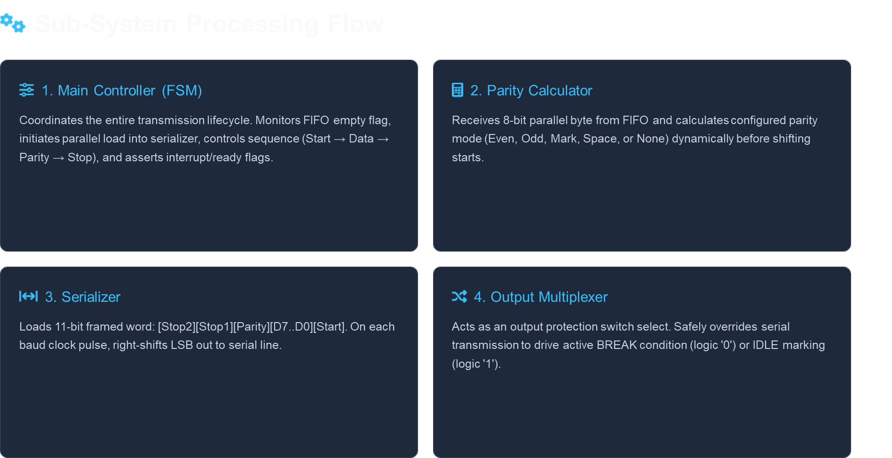
Sub-System Processing Flow
DATA FLOW AND MODULE RESPONSIBILITIES

Slide 4



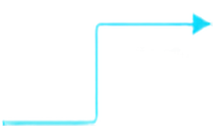
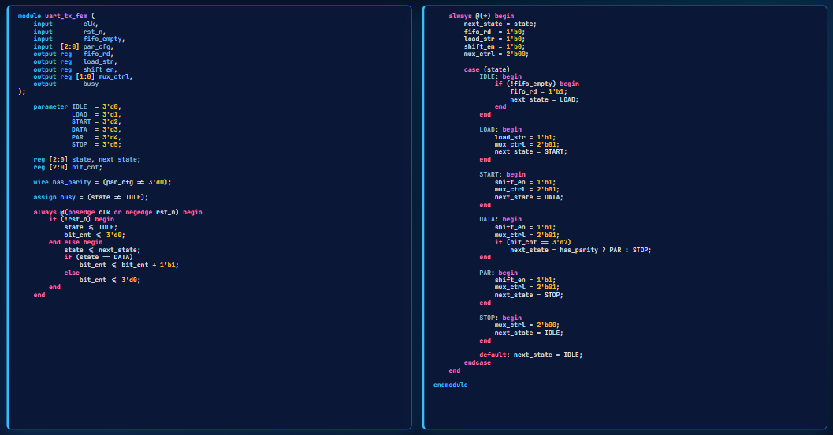

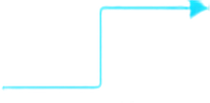





Main Controller Verilog Code
Synthesizable FSM for UART frame transmission
01
Inputs
Clock, reset, FIFO empty, and parity mode drive the controller.
02
State Register
Asynchronous reset returns FSM to IDLE for safe startup.
03
Next State Logic
Combinational logic determines the next state for each condition.
04
Output Control
rd_en, shift_en, and tx_out are asserted per state to drive transmit.
05
Frame Cycle
Transitions sequence through START, DATA, optional parity, then STOP.

Slide 5

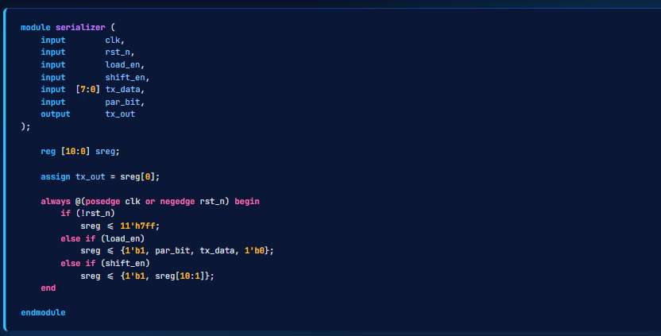
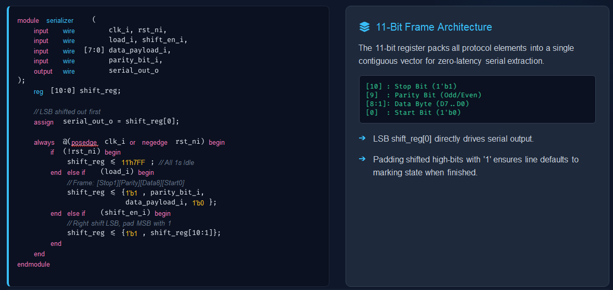
Serializer Module & Frame Architecture

Slide 6

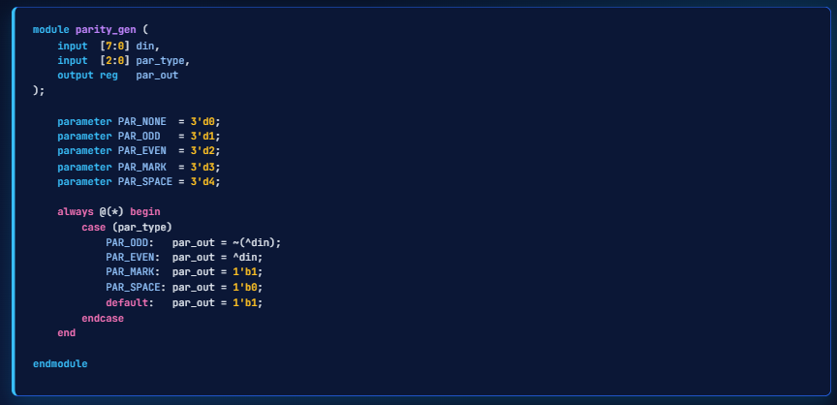
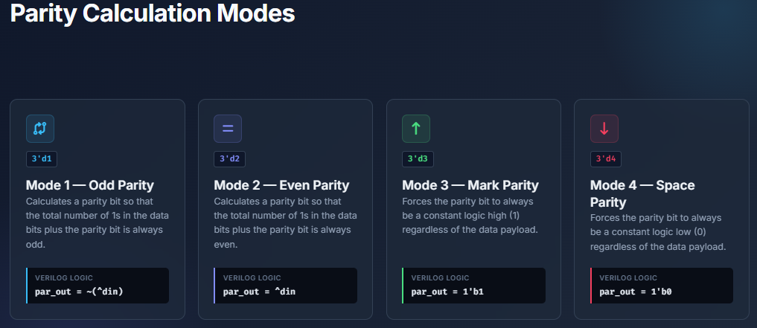
Parity Generator Module
Computes the parity bit based on configured mode

Slide 7


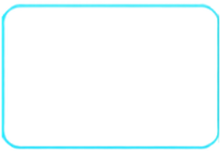
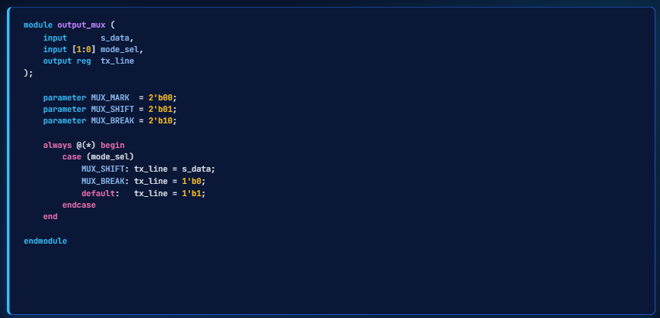






Output Multiplexer Module
GLITCH-FREE ROUTING FOR LINE INTEGRITY
serial shift
OUTPUT
MUX
TXD
register output
line signal
CTRL SHIFT
CTRL BREAK
CTRLIDLE
normal
forces
forces
data output
continuous
line high
low
during reset
RELIABLE SIGNAL CONTROL
Routes data, break, or idle states to the TXD line. Ensures strong line driving in all modes. Glitch-free switching preserves signal stability and line integrity.

Slide 8

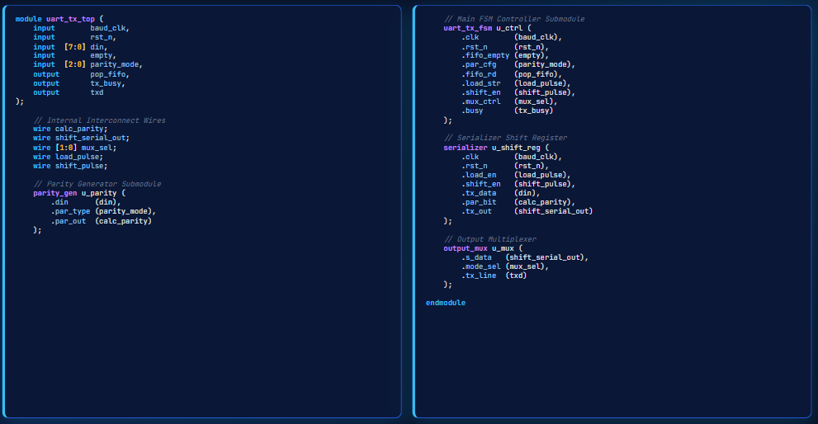
Top-Level Module Structural Integration
Complete UART Transmitter in Verilog

Slide 9
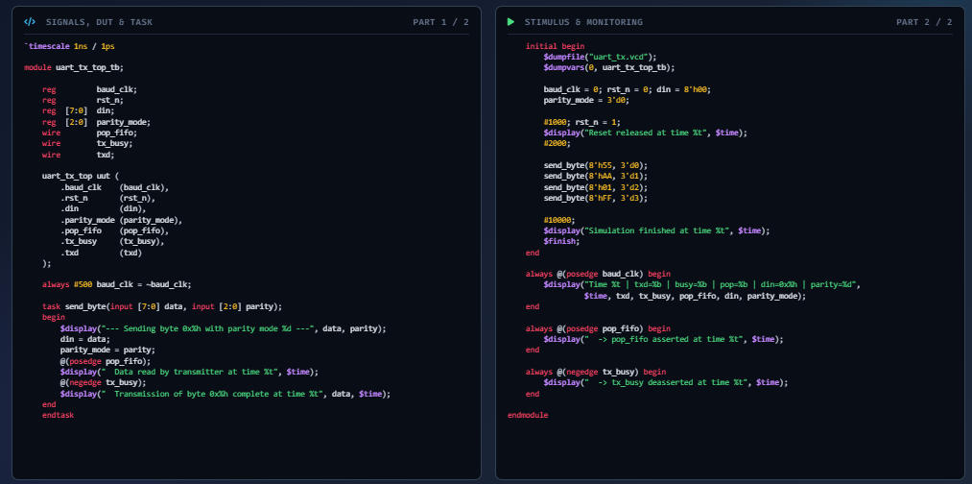
UART TX Testbench

Slide 10
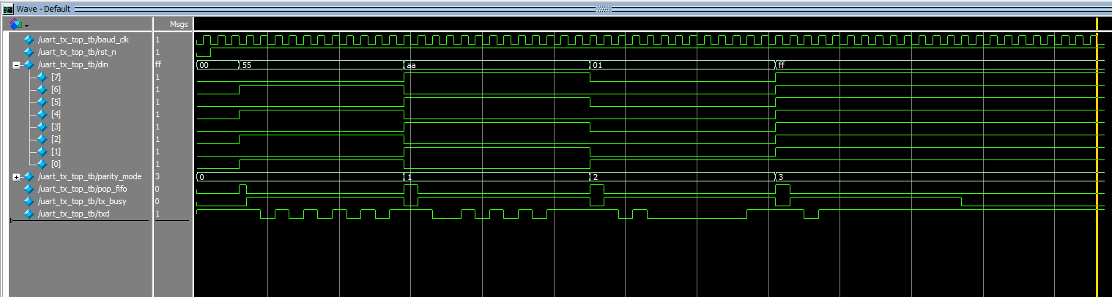
Wave Output

Slide 11

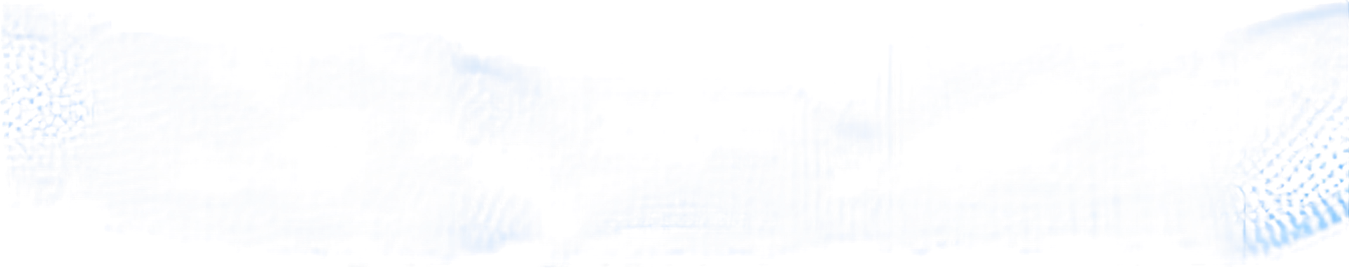
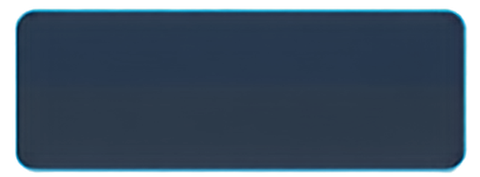
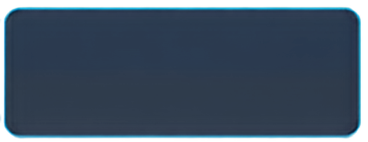
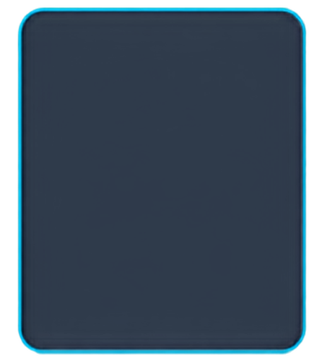


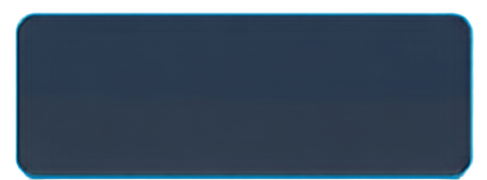
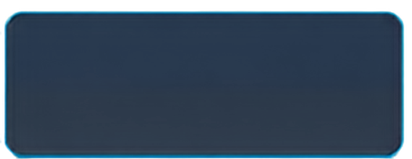
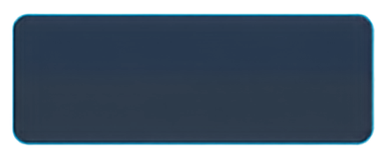
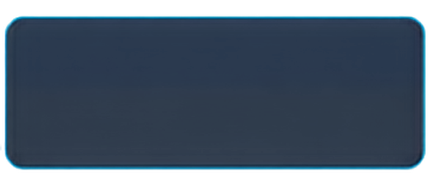


Project Summary & Specifications
KEY FEATURES AND DESIGN CLAIMS
FULLY MODULAR DESIGN
GLITCH-FREE OUTPUT_MUX
matches the architecture block diagram
glitch-free multiplexer switching for stable TX line
100%
CLEAN FIFO HANDSHAKING
MAX FRAME WIDTH
interface only,
FIFO not implemented
SYNTHESIZABLE VERILOG CODE
11 bits
(start + 8 data + parity + stop)
compatible with FPGA/ASIC tools
5 PARITY MODES SUPPORTED
ZERO LATCH-PRONE LOGIC
odd, even, mark, space, none
safe, synthesizable combinational design
EDUCATIONAL AND PRACTICAL: A CLEAN, SYNTHESIZABLE UART TRANSMITTER DESIGN

